Slide 1
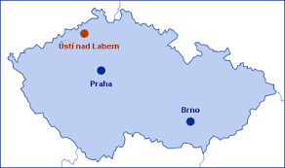

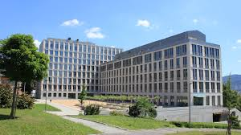





FACULTY OF SCIENCE,
JAN EVANGELISTA PURKYNĚ UNIVERSITY IN ÚSTÍ NAD LABEM
Home
AI in STEM education
Start Presentation
Kateřina Jančaříková katerina.jancarikova@ujep.cz

Slide 2


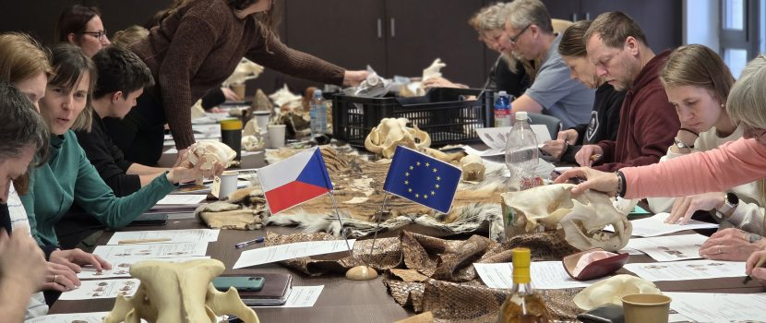
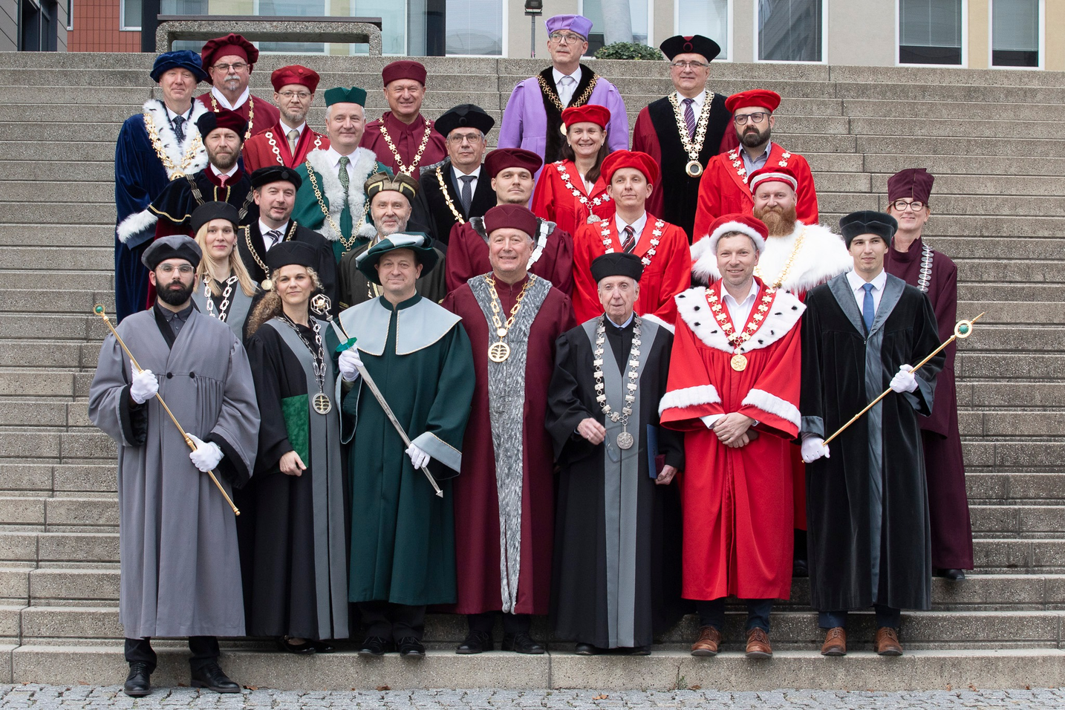
FTRANSFORMING THE REGION THROUGH SCIENCE & EDUCATION"
About Our Faculty
1000 students
100 academics and researchers
6 Departmens and 2 Centres
THYNK UNLIMITED
Founded in 2025 our faculty has established itself as a leading institution in higher science education, committed to academic excellence and innovation, we provide a diverse and inclusive.
Our greatest asset is our people—a dedicated team of world-class researchers and passionate educators who inspire the next generation of STEM leaders.
Faculty of Science, Jan Evangelista Purkyně University in Ústí nad Labem

Slide 3


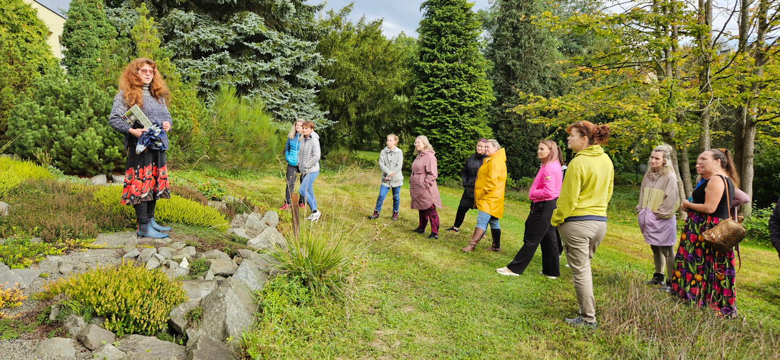
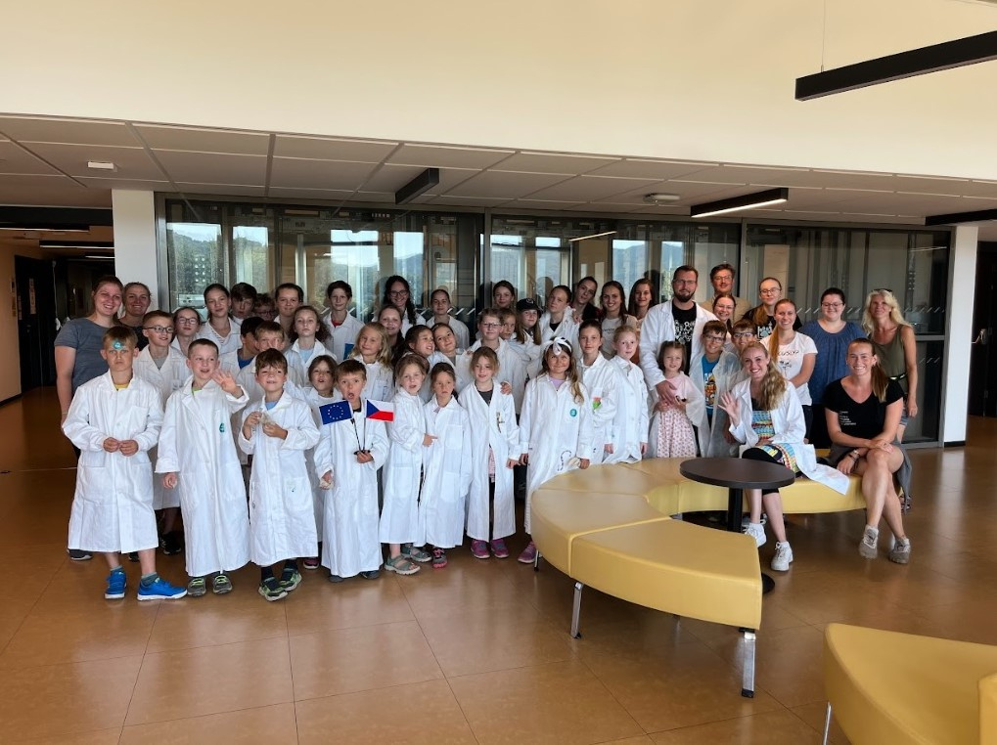
FACULTY OF SCIENCE,
JAN EVANGELISTA PURKYNĚ UNIVERSITY IN ÚSTÍ NAD LABEM
THYNK UNLIMITED
Home
Our Vision and Mission
  Pre-service Training: Preparing future STEM teachers.
  Lifelong professional development for educators.
  Talent Support: Nurturing STEM-gifted students.
was founded on March 2020 as the eighth part of the Faculty of Science UJEP
Slide
3
Kateřina Jančaříková katerina.jancarikova@ujep.cz

Slide 4
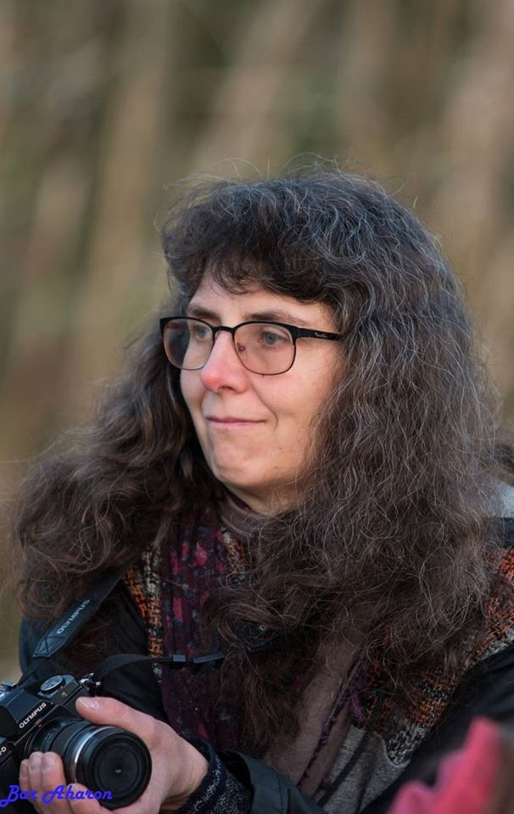


ASSISTANT PROFESSOR / RESEARCHER
FACULTY OF SCIENCE,
JAN EVANGELISTA PURKYNĚ UNIVERSITY IN ÚSTÍ NAD LABEM
&
FACULTY OF SCIENCE, HUMANITIES AND EDUCATION, TECHNICAL UNIVERSITY OF LIBEREC
ABOUT ME
Kateřina Jančaříková
Head of the Centre for the Promotion of Science Education
Faculty of Science
Jan Evangelista Purkyně University in Ústí nad Labem
KJ
Professional Profile & Mission
"At the university, teachers and students are not there for each other, but both are there for the pursuit of truth." — Wilhelm von Humboldt
Kateřina Jančaříková
Kateřina Jančaříková katerina.jancarikova@ujep.cz

Slide 5
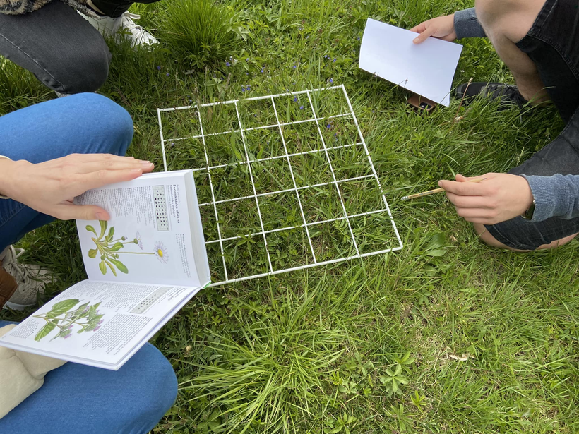
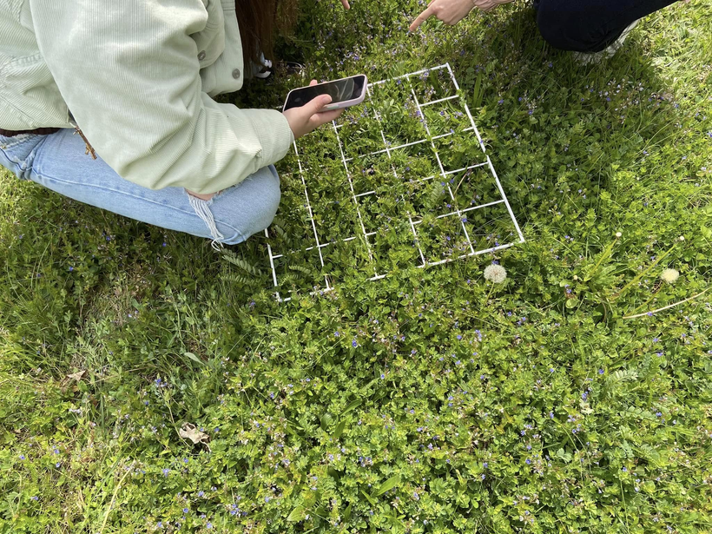
ABOUT ME
Home
KJ
FACULTY OF SCIENCE,
JAN EVANGELISTA PURKYNĚ UNIVERSITY IN ÚSTÍ NAD LABEM
From Pen&Paper to Pixels
The progres
  I remember when my most advanced 'hardware' was a sharpened pencil and a rainy day was our biggest database error.
  We were dreaming of the future while our backpacks were full of heavy paper notebooks. Now, the future is in our pockets.
Kateřina Jančaříková katerina.jancarikova@ujep.cz

Slide 6
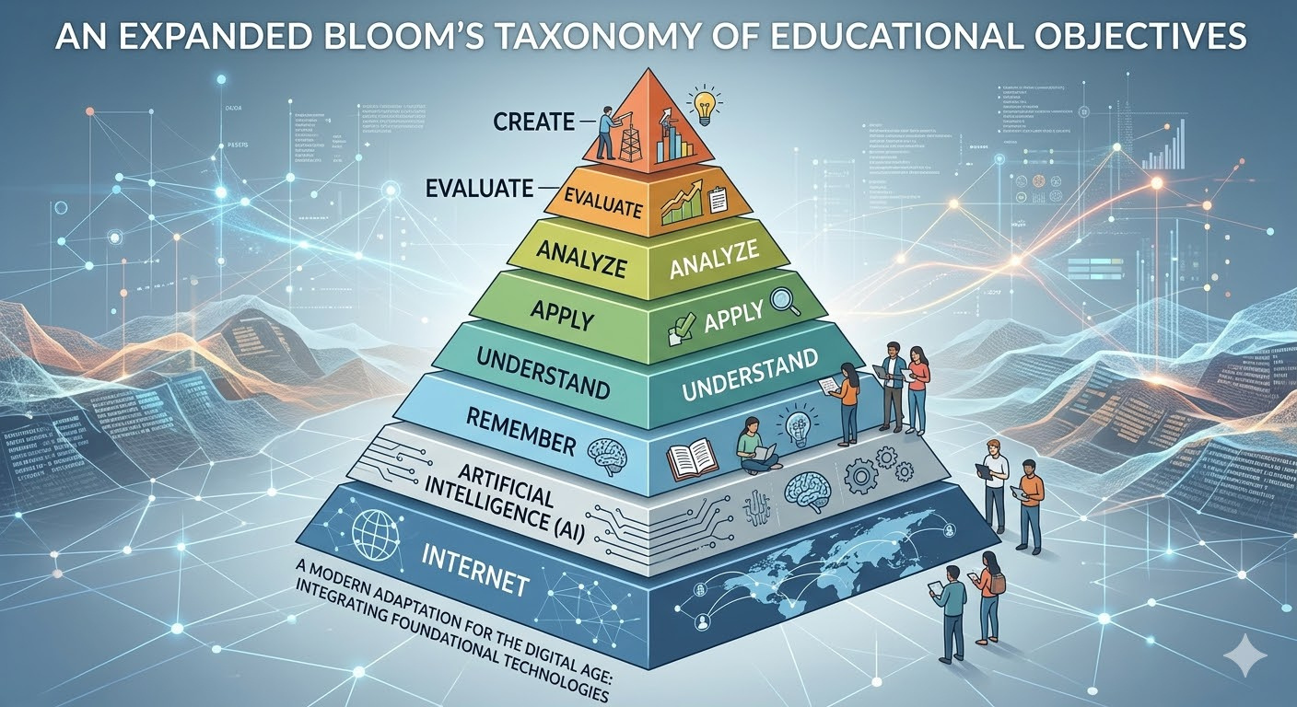

Redefining Bloom's Taxonomy for the AI Era
FACULTY OF SCIENCE,
JAN EVANGELISTA PURKYNĚ UNIVERSITY IN ÚSTÍ NAD LABEM
A whole new ball game!
Everything has
changed!
Kateřina Jančaříková katerina.jancarikova@ujep.cz

Slide 7
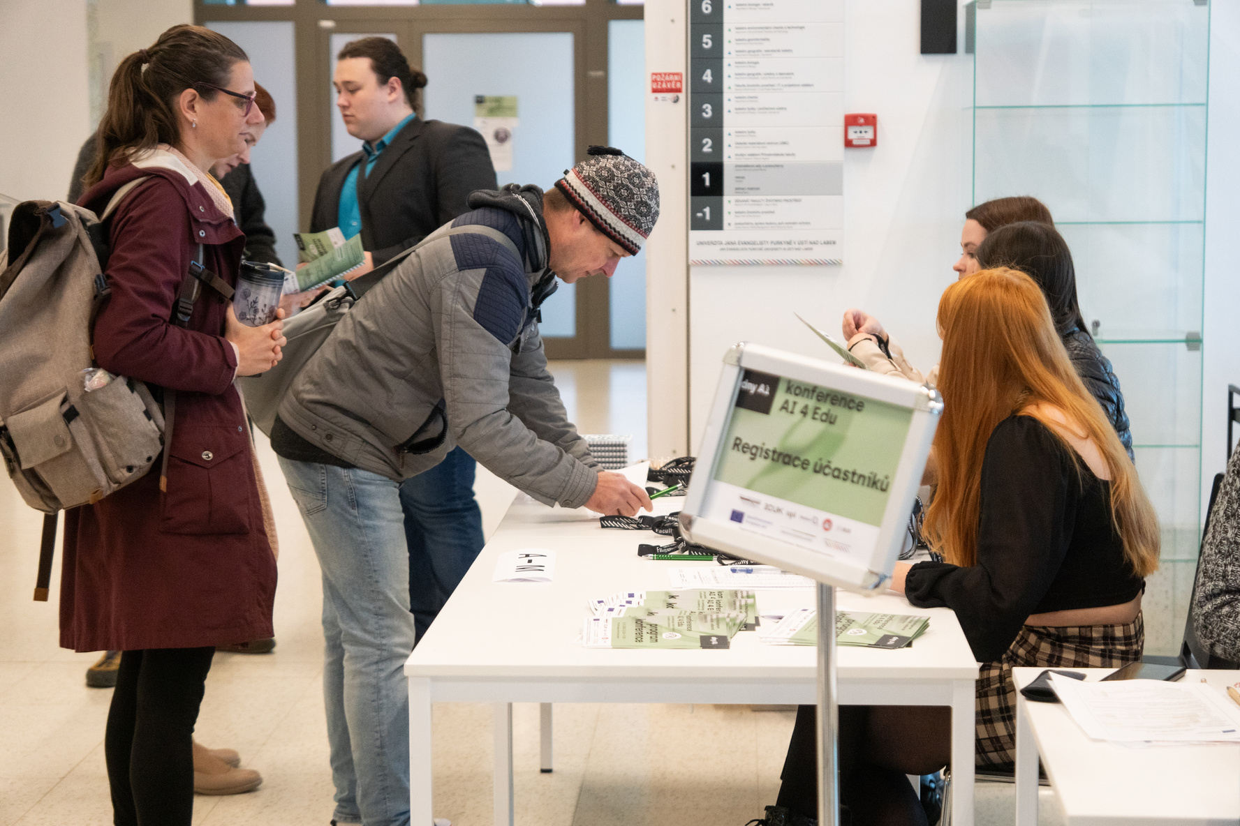


Our Faculty’s Strategic Approach
FACULTY OF SCIENCE,
JAN EVANGELISTA PURKYNĚ UNIVERSITY IN ÚSTÍ NAD LABEM
Embracing Innovation: A strategic decision to integrate AI responsibly rather than restrict its use.
  Annual AI Conferences (from 2024)
  Institutional Gemini License: Full access for all staff and students.
  LM Notebooks: High-performance hardware provided for the entire academic community.
Building a Knowledge Community (Academics, Students,
No-academic Staff,
Mentors & Clinical Teacher)
Kateřina Jančaříková katerina.jancarikova@ujep.cz

Slide 8
AI + STEM = Smart Science
  Lesson planning.
  Selecting topic-specific games & activities.
  Differentiated instruction.
  Cross-curricular links.
  Designing activities: Experiments, games, and interactive tasks.
  Assessment and feedback.
  Simulating the "inquisitive student".
  Test preparation and knowledge verification.
  Proofreading and text editing.
  Image generation for visualization.
  Communication support: Parents, school management, and colleagues.
Practical Experience with Gemini
Kateřina Jančaříková katerina.jancarikova@ujep.cz

Slide 9
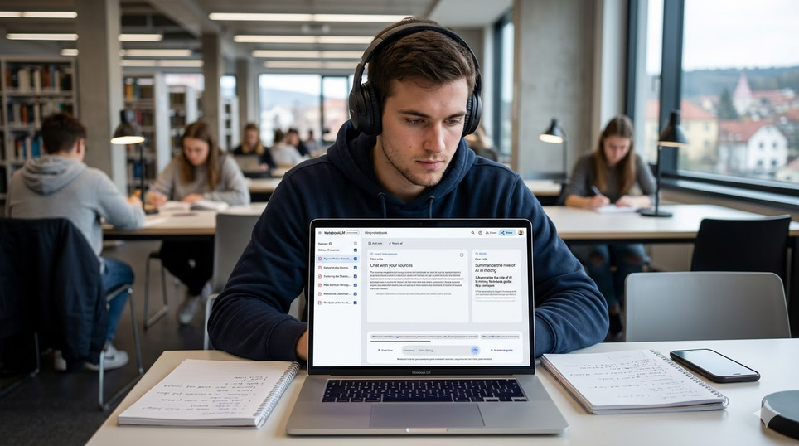
STEM'S DIGITAL BRAIN
GEMINI ILUSTRATION LIMITS
Practical Experience with Notebook lm
Source Input: Transforming static PDF materials.
Output Formats: AI-generated podcasts, study sets (flashcards), pictures, and quizzes.
Performance Metric: Low satisfaction levels.
AI Hallucinations & Limitations
Kateřina Jančaříková katerina.jancarikova@ujep.cz

Slide 10
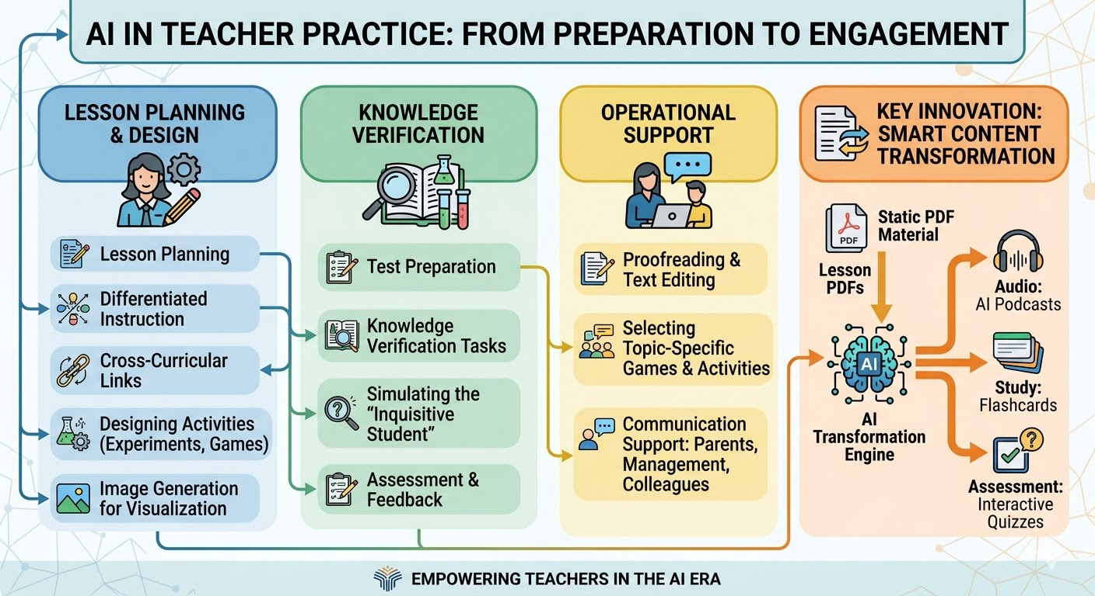
GEMINI ILUSTRATION
Kateřina Jančaříková katerina.jancarikova@ujep.cz

Slide 11
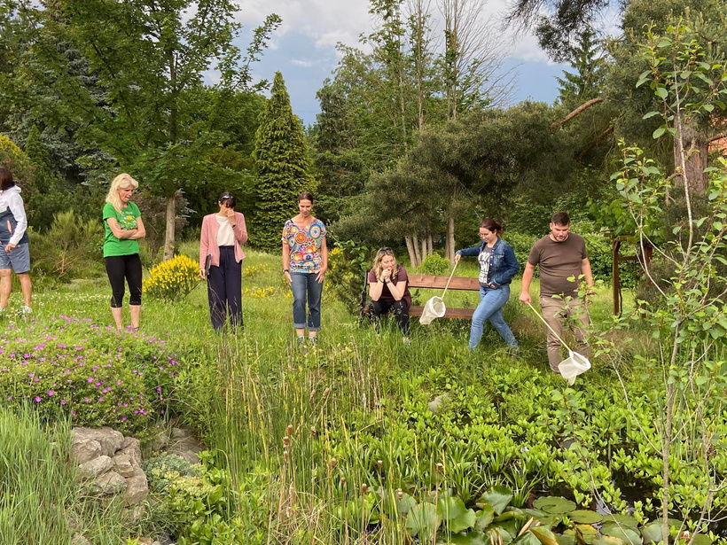

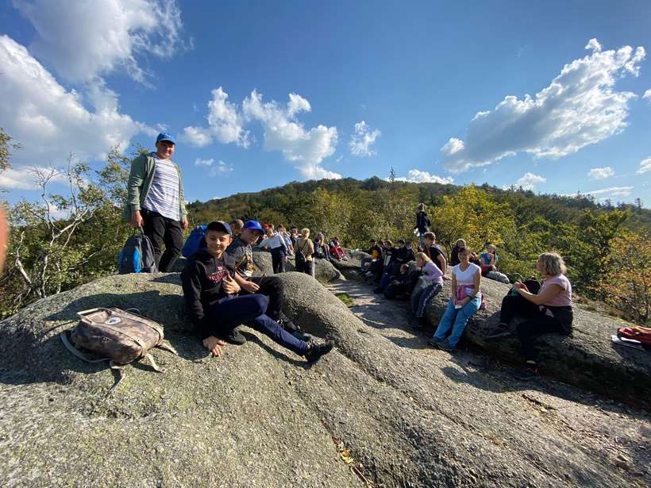
AI: Your Co-Pilot in Discovery
Home
FACULTY OF SCIENCE,
JAN EVANGELISTA PURKYNĚ UNIVERSITY IN ÚSTÍ NAD LABEM
Biology & Nature Identification
AI in the Wild
  Merlin Bird ID: A gold standard by Cornell Lab of Ornithology for bird sound and photo identification.
  Seek by iNaturalist: The ultimate "all-rounder" for schools. No registration needed, uses AR for real-time identification with gamification (badges).
  PlantNet (Pl@ntNet): "Shazam for plants" – massive database, highly accurate for wild flora.
Kateřina Jančaříková katerina.jancarikova@ujep.cz

Slide 12
Home
FACULTY OF SCIENCE,
JAN EVANGELISTA PURKYNĚ UNIVERSITY IN ÚSTÍ NAD LABEM
The other STEM subjects
  Google Lens (Homework Helper): Analyzes physical problems and chemical equations; provides step-by-step logic, not just results.
  Mathpix Snip: The "magic" tool. Converts handwritten formulas into LaTeX and provides instant digital solutions.
  SkyView: AR-powered sky mapping. Identifies stars, planets, and the ISS even through clouds.
  PeakVisor: Uses GPS and AI to identify mountain peaks, providing elevation and geographic details in real-time.
  MolView: Web-based tool linking databases to generate 3D models and spectral data.
  Beaker by THIX: Turns a smartphone into a virtual beaker for risk-free chemical reactions (burns, explosions).
  Chemistry - Periodic Table: Includes an AI module for balancing chemical equations and explaining reaction types.
  Chatbots.
  Personal AI Avatars in Education etc.
Kateřina Jančaříková katerina.jancarikova@ujep.cz

Slide 13
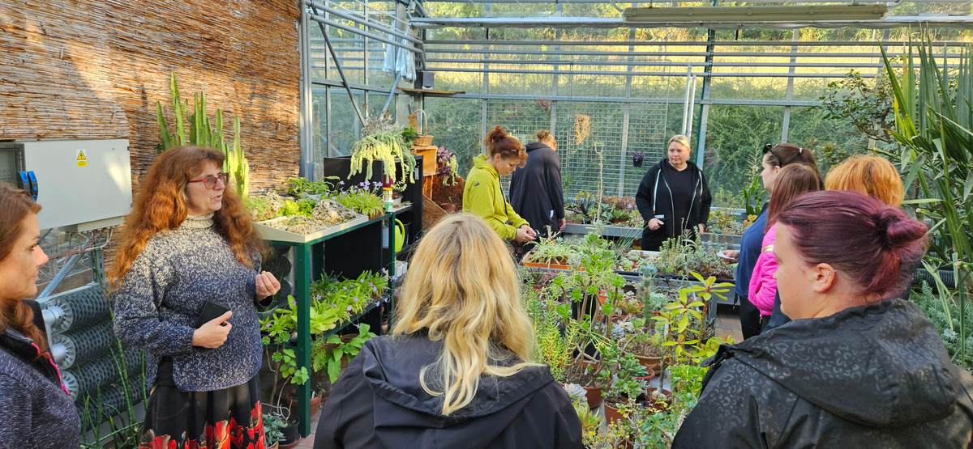

FACULTY OF SCIENCE,
JAN EVANGELISTA PURKYNĚ UNIVERSITY IN ÚSTÍ NAD LABEM
Beyond the Screen
Finding the Balance
AI as a risk
of alienation from nature and people
A good servant, but a bad master
Kateřina Jančaříková katerina.jancarikova@ujep.cz

Slide 14
ABOUT ME
Home
FACULTY OF SCIENCE,
JAN EVANGELISTA PURKYNĚ UNIVERSITY IN ÚSTÍ NAD LABEM
Biology & Nature Identification
AI in the Wild
  Merlin Bird ID: A gold standard by Cornell Lab of Ornithology for bird sound and photo identification.
  Seek by iNaturalist: The ultimate "all-rounder" for schools. No registration needed, uses AR for real-time identification with gamification (badges).
  PlantNet (Pl@ntNet): "Shazam for plants" – massive database, highly accurate for wild flora.
Kateřina Jančaříková katerina.jancarikova@ujep.cz

Slide 15
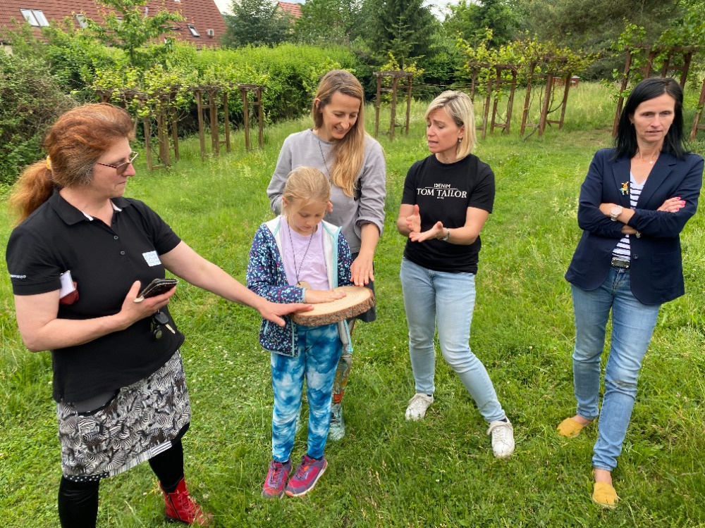


THYNK UNLIMITED
Thank You
For YourAttention
Phone Number
Email
+420723550524
katerina.jancarikova@ujep.cz
See You Next Time
KJ
Kateřina Jančaříková

